Slide 1
Information Security Fall 2023

Slide 2
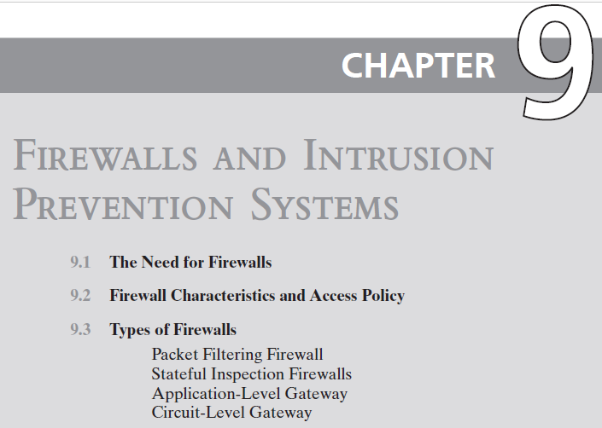
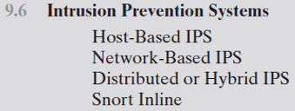
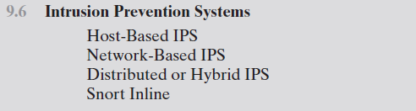


Slide 3
Intrusion Prevention Systems (IPS)
Also known as Intrusion Detection and Prevention System (IDPS)
Is an extension of an IDS that includes the capability to attempt to block or prevent detected malicious activity
Can be host-based, network-based, or distributed/hybrid
Can use anomaly detection to identify behavior that is not that of legitimate users, or signature/heuristic detection to identify known malicious behavior can block traffic as a firewall does, but makes use of the types of algorithms developed for IDSs to determine when to do so
Notes:
A further addition to the range of security products is the intrusion prevention system
(IPS), also known as intrusion detection and prevention system (IDPS). It is
an extension of an IDS that includes the capability to attempt to block or prevent
detected malicious activity. Like an IDS, an IPS can be host-based, network-based,
or distributed/hybrid, as we discuss in Chapter 8. Similarly, it can use anomaly
detection to identify behavior that is not that of legitimate users, or signature/heuristic
detection to identify known malicious behavior.
Once an IDS has detected malicious activity, it can respond by modifying
or blocking network packets across a perimeter or into a host, or by modifying or
blocking system calls by programs running on a host. Thus, a network IPS can block
traffic, as a firewall does, but makes use of the types of algorithms developed for
IDSs to determine when to do so. It is a matter of terminology whether a network
IPS is considered a separate, new type of product or simply another form of firewall.

Slide 4
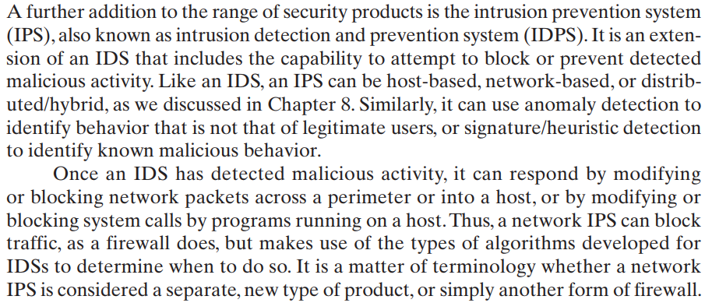

Slide 5
Host-Based IPS (HIPS)
Can make use of either signature/heuristic or anomaly detection techniques to identify attacks
Signature: focus is on the specific content of application network traffic, or of sequences of system calls, looking for patterns that have been identified as malicious
Anomaly: IPS is looking for behavior patterns that indicate malware
Examples of the types of malicious behavior addressed by a HIPS include:
Modification of system resources
Privilege-escalation exploits
Buffer-overflow exploits
Access to e-mail contact list
Directory traversal
Notes:
A host-based IPS (HIPS) can make use of either signature/heuristic or anomaly
detection techniques to identify attacks. In the former case, the focus is on the specific
content of application network traffic, or of sequences of system calls, looking
for patterns that have been identified as malicious. In the case of anomaly detection,
the IPS is looking for behavior patterns that indicate malware. Examples of the
types of malicious behavior addressed by a HIPS include the following:
• Modification of system resources: Rootkits, Trojan horses, and backdoors
operate by changing system resources, such as libraries, directories, registry
settings, and user accounts.
• Privilege-escalation exploits: These attacks attempt to give ordinary users
root access.
• Buffer-overflow exploits: These attacks are described in Chapter 10 .
• Access to e-mail contact list: Many worms spread by mailing a copy of themselves
to addresses in the local system’s e-mail address book.
• Directory traversal: A directory traversal vulnerability in a Web server allows
the hacker to access files outside the range of what a server application user
would normally need to access.

Slide 6
Host-Based IPS (HIPS)
Examples of the types of malicious behavior addressed by a HIPS include the following:
Modification of system resources: Rootkits, Trojan horses, and backdoors operate by changing system resources, such as libraries, directories, registry settings, and user accounts.
Privilege-escalation exploits: These attacks attempt to give ordinary users root access.
Buffer-overflow exploits: Attackers exploit buffer overflow issues by overwriting the memory of an application
Access to e-mail contact list: Many worms spread by mailing a copy of themselves to addresses in the local system’s e-mail address book.
Directory traversal: A directory traversal vulnerability in a Web server allows the hacker to access files outside
Notes:
A host-based IPS (HIPS) can make use of either signature/heuristic or anomaly
detection techniques to identify attacks. In the former case, the focus is on the specific
content of application network traffic, or of sequences of system calls, looking
for patterns that have been identified as malicious. In the case of anomaly detection,
the IPS is looking for behavior patterns that indicate malware. Examples of the
types of malicious behavior addressed by a HIPS include the following:
• Modification of system resources: Rootkits, Trojan horses, and backdoors
operate by changing system resources, such as libraries, directories, registry
settings, and user accounts.
• Privilege-escalation exploits: These attacks attempt to give ordinary users
root access.
• Buffer-overflow exploits: These attacks are described in Chapter 10 .
• Access to e-mail contact list: Many worms spread by mailing a copy of themselves
to addresses in the local system’s e-mail address book.
• Directory traversal: A directory traversal vulnerability in a Web server allows
the hacker to access files outside the range of what a server application user
would normally need to access.

Slide 7
HIPS
Capability can be tailored to the specific platform
A set of general purpose tools may be used for a desktop or server system
Some packages are designed to protect specific types of servers, such as Web servers and database servers
In this case the HIPS looks for particular application attacks
Can use a sandbox approach
Sandboxes are especially suited to mobile code such as Java applets and scripting languages
HIPS quarantines such code in an isolated system area then runs the code and monitors its behavior
Areas for which a HIPS typically offers desktop protection:
System calls
File system access
System registry settings
Host input/output
Notes:
Attacks such as these result in behaviors that can be analyzed by a HIPS. The
HIPS capability can be tailored to the specific platform. A set of general-purpose
tools may be used for a desktop or server system. Some HIPS packages are designed
to protect specific types of servers, such as Web servers and database servers. In this
case, the HIPS looks for particular application attacks.
In addition to signature and anomaly-detection techniques, a HIPS can use
a sandbox approach. Sandboxes are especially suited to mobile code, such as Java
applets and scripting languages. The HIPS quarantines such code in an isolated
system area, then runs the code and monitors its behavior. If the code violates
predefined policies or matches predefined behavior signatures, it is halted and
prevented from executing in the normal system environment.
[ROBB06a] lists the following as areas for which a HIPS typically offers desktop
protection:
• System calls: The kernel controls access to system resources such as memory,
I/O devices, and processor. To use these resources, user applications invoke
system calls to the kernel. Any exploit code will execute at least one system
call. The HIPS can be configured to examine each system call for malicious
characteristics.
• File system access: The HIPS can ensure that file access system calls are not
malicious and meet established policy.
System registry settings: The registry maintains persistent configuration
information about programs and is often maliciously modified to extend the
life of an exploit. The HIPS can ensure that the system registry maintains its
integrity.
• Host input/output: I/O communications, whether local or network based, can
propagate exploit code and malware. The HIPS can examine and enforce
proper client interaction with the network and its interaction with other
devices.

Slide 8
Host-Based IPS (HIPS)
[ROBB06a] lists the following as areas for which a HIPS typically offers desktop protection:
System calls: The kernel controls access to system resources such as memory, I/O devices, and processor. To use these resources, user applications invoke system calls to the kernel. Any exploit code will execute at least one system call. The HIPS can be configured to examine each system call for malicious characteristics.
File system access: The HIPS can ensure that file access system calls are not malicious and meet established policy.
System registry settings: The registry maintains persistent configuration information about programs and is often maliciously modified to extend the life of an exploit. The HIPS can ensure that the system registry maintains its integrity.
Host input/output: I/O communications, whether local or network-based, can propagate exploit code and malware. The HIPS can examine and enforce proper client interaction with the network and its interaction with other devices.

Slide 9
The Role of HIPS
Many industry observers see the enterprise endpoint, including desktop and laptop systems, as now the main target for hackers and criminals
Thus security vendors are focusing more on developing endpoint security products
Traditionally, endpoint security has been provided by a collection of distinct products, such as antivirus, antispyware, antispam, and personal firewalls
Approach is an effort to provide an integrated, single-product suite of functions
Advantages of the integrated HIPS approach are that the various tools work closely together, threat prevention is more comprehensive, and management is easier
A prudent approach is to use HIPS as one element in a defense-in-depth strategy that involves network-level devices, such as either firewalls or network-based IPSs
Notes:
Many industry observers see the enterprise endpoint,
including desktop and laptop systems, as now the main target for hackers and
criminals, more so than network devices [ROBB06b]. Thus, security vendors are
focusing more on developing endpoint security products. Traditionally, endpoint
security has been provided by a collection of distinct products, such as antivirus,
antispyware, antispam, and personal firewalls. The HIPS approach is an effort to
provide an integrated, single-product suite of functions. The advantages of the
integrated HIPS approach are that the various tools work closely together, threat
prevention is more comprehensive, and management is easier.
It may be tempting to think that endpoint security products such as HIPS,
if sophisticated enough, eliminate or at least reduce the need for network-level
devices. For example, the San Diego Supercomputer Center reports that over a
four-year period, there were no intrusions on any of its managed machines, in a
configuration with no firewalls and just endpoint security protection [SING03].
Nevertheless, a more prudent approach is to use HIPS as one element in a strategy
that involves network-level devices, such as either firewalls or network-based
IPSs.

Slide 10
Network-Based IPS (NIPS)
Inline NIDS with the authority to modify or discard packets and tear down TCP connections
Makes use of signature/heuristic detection and anomaly detection
May provide flow data protection
Requires that the application payload in a sequence of packets be reassembled
Methods used to identify malicious packets:
Pattern matching
Stateful matching
Protocol anomaly
Traffic anomaly
Statistical anomaly
Notes:
A network-based IPS (NIPS) is in essence an inline NIDS with the authority to
discard packets and tear down TCP connections. As with a NIDS, a NIPS makes use
of techniques such as signature detection and anomaly detection.
Among the techniques used in a NIPS but not commonly found in a firewall
is flow data protection. This requires that the application payload in a sequence
of packets be reassembled. The IPS device applies filters to the full content of the
flow every time a new packet for the flow arrives. When a flow is determined to be
malicious, the latest and all subsequent packets belonging to the suspect flow are
dropped.
In terms of the general methods used by a NIPS device to identify malicious
packets, the following are typical:
• Pattern matching: Scans incoming packets for specific byte sequences (the
signature) stored in a database of known attacks
• Stateful matching: Scans for attack signatures in the context of a traffic stream
rather than individual packets
• Protocol anomaly: Looks for deviation from standards set forth in RFCs
Traffic anomaly: Watches for unusual traffic activities, such as a flood of UDP
packets or a new service appearing on the network
• Statistical anomaly: Develops baselines of normal traffic activity and throughput,
and alerts on deviations from those baselines

Slide 11
Network-Based IPS (NIPS)
In terms of the general methods used by a NIPS device to identify malicious packets, the following are typical:
Pattern matching: Scans incoming packets for specific byte sequences (the signature) stored in a database of known attacks
Stateful matching: Scans for attack signatures in the context of a traffic stream rather than individual packets
Protocol anomaly: Looks for deviation from standards set forth in RFCs
Traffic anomaly: Watches for unusual traffic activities, such as a flood of UDP packets or a new service appearing on the network
Statistical anomaly: Develops baselines of normal traffic activity and throughput, and alerts on deviations from those baselines

Slide 12
Distributed or Hybrid IPS
The final category of IPS is in a distributed or hybrid approach.
This gathers data from a large number of host and network-based sensors, relays this intelligence to a central analysis system able to correlate, and analyze the data, which can then return updated signatures and behavior patterns to enable all of the coordinated systems to respond and defend against malicious behavior.
A number of such systems have been proposed. One of the best known is the digital immune system.

Slide 13
Digital Immune System
Comprehensive defense against malicious behavior caused by malware
Developed by IBM and refined by Symantec
Motivation for this development includes the rising threat of Internet-based malware, the increasing speed of its propagation provided by the Internet, and the need to acquire a global view of the situation
Success depends on the ability of the malware analysis system to detect new and innovative malware strains
Notes:
The final category of IPS is in a distributed or hybrid approach. This gathers data
from a large number of host and network-based sensors, relays this intelligence to
a central analysis system able to correlate, and analyze the data, which can then
return updated signatures and behavior patterns to enable all of the coordinated
systems to respond and defend against malicious behavior. A number of such systems
have been proposed. One of the best known is the digital immune system.
The digital immune system is a comprehensive defense
against malicious behavior caused by malware, developed by IBM [KEPH97a,
KEPH97b, WHIT99], and subsequently refined by Symantec [SYMA01] and
incorporated into its Central Quarantine produce [SYMA05]. The
motivation for this development includes the rising threat of Internet-based
malware, the increasing speed of its propagation provided by the Internet, and the
need to acquire a global view of the situation.
In response to the threat posed by these Internet-based capabilities, IBM
developed the original prototype digital immune system. This system expands on
the use of program emulation discussed in Section 6.10 and provides a general-purpose
emulation and malware detection system. The objective of this system is to
provide rapid response time so that malware can be stamped out almost as soon as
they are introduced. When new malware enters an organization, the immune system
automatically captures it, analyzes it, adds detection and shielding for it, removes it,
and passes information about it to client systems, so the malware can be detected
before it is allowed to run elsewhere.
The success of the digital immune system depends on the ability of the malware
analysis system to detect new and innovative malware strains. By constantly
analyzing and monitoring malware found in the wild, it should be possible to continually
update the digital immune software to keep up with the threat.

Slide 14
Figure 9.5 Placement of Malware Monitors (adapted from [SIDI05])
Notes:
Figure 9.5 shows an example of a hybrid architecture designed originally to
detect worms [SIDI05]. The system works as follows (numbers in figure refer to
numbers in the following list):
1. Sensors deployed at various network and host locations detect potential malware
scanning, infection or execution. The sensor logic can also be incorporated
in IDS sensors.
2. The sensors send alerts and copies of detected malware to a central server,
which correlates and analyzes this information. The correlation server determines
the likelihood that malware is being observed and its key characteristics.
3. The server forwards its information to a protected environment, where the
potential malware may be sandboxed for analysis and testing.
4. The protected system tests the suspicious software against an appropriately
instrumented version of the targeted application to identify the vulnerability.
5. The protected system generates one or more software patches and tests these.
6. If the patch is not susceptible to the infection and does not compromise the
application’s functionality, the system sends the patch to the application host
to update the targeted application.

Slide 15
Figure 9.5 shows an example of a hybrid architecture designed originally to detect worms [SIDI05]. The system works as follows (numbers in figure refer to numbers in the following list):
Sensors deployed at various network and host locations detect potential malware scanning, infection or execution. The sensor logic can also be incorporated in IDS sensors.
The sensors send alerts and copies of detected malware to a central server, which correlates and analyzes this information. The correlation server determines the likelihood that malware is being observed and its key characteristics.
The server forwards its information to a protected environment, where the potential malware may be sandboxed for analysis and testing.
The protected system tests the suspicious software against an appropriately instrumented version of the targeted application to identify the vulnerability.
The protected system generates one or more software patches and tests these.
If the patch is not susceptible to the infection and does not compromise the application’s functionality, the system sends the patch to the application host to update the targeted application.

Slide 16
Snort Inline
Drop
Snort rejects a packet based on the options defined in the rule and logs the result
Reject
Packet is rejected and result is logged and an error message is returned
Sdrop
Packet is rejected but not logged
Enables Snort to function as an intrusion prevention system
Includes a replace option which allows the Snort user to modify packets rather than drop them
Useful for a honeypot implementation
Attackers see the failure but cannot figure out why it occurred
Notes:
We introduced Snort in Section 8.9 as a lightweight intrusion detection system.
A modified version of Snort, known as Snort Inline [KURU12],
enhances Snort to function as an intrusion prevention system. Snort Inline adds three new rule types that
provide intrusion prevention features:
• Drop: Snort rejects a packet based on the options defined in the rule and logs
the result.
• Reject: Snort rejects a packet and logs the result. In addition, an error message
is returned. In the case of TCP, this is a TCP reset message, which resets the
TCP connection. In the case of UDP, an ICMP port unreachable message is
sent to the originator of the UDP packet.
• Sdrop: Snort rejects a packet but does not log the packet.
Snort Inline includes a replace option, which allows the Snort user to modify
packets rather than drop them. This feature is useful for a honeypot implementation
[SPIT03]. Instead of blocking detected attacks, the honeypot modifies and
disables them by modifying packet content. Attackers launch their exploits, which
travel the Internet and hit their intended targets, but Snort Inline disables the
attacks, which ultimately fail. The attackers see the failure but can’t figure out why
it occurred. The honeypot can continue to monitor the attackers while reducing the
risk of harming remote systems.

